Slide 1
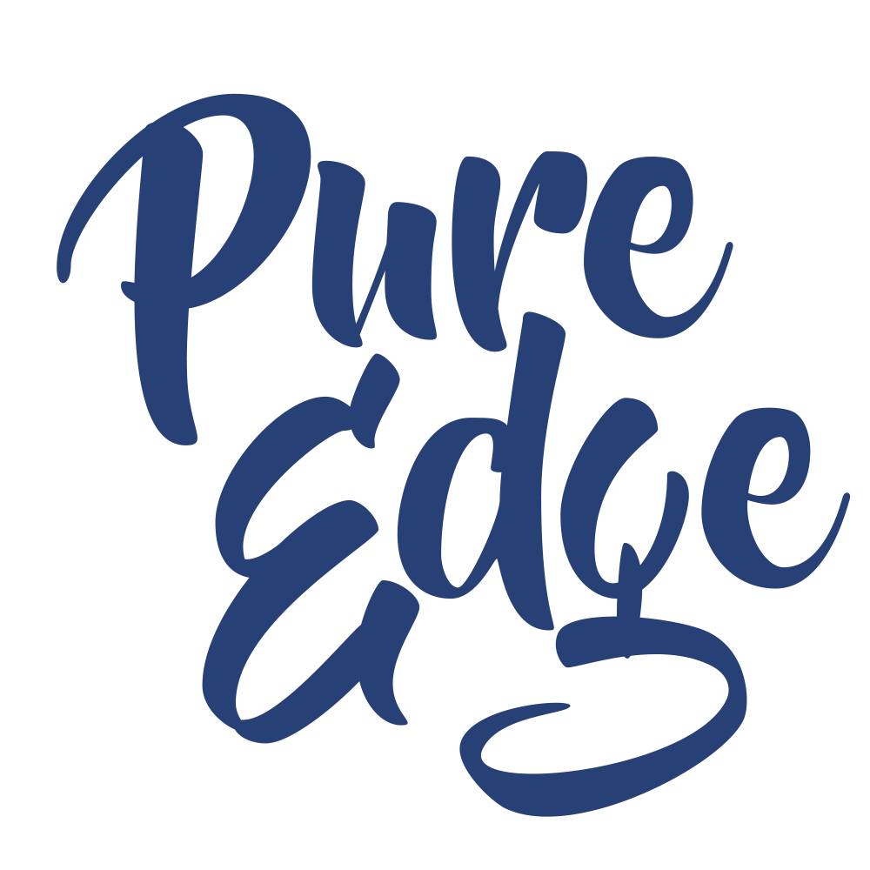

Everglades Foundation
The Neuroscience of Stress & the Reciprocity of Self-Care
July 24, 2020
Follow us @pureedgeinc
Website: www.pureedgeinc.org
Email: getmoving@pureedgeinc.org
©2020 Pure Edge, Inc.

Slide 2
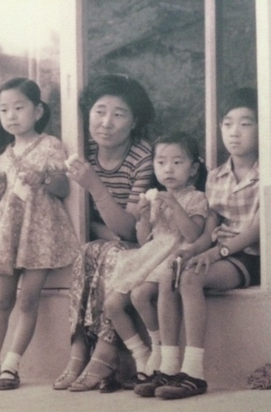
  Chi Kim, CEO chi@pureedgeinc.org
Immigrant – South Korea
Worked since age 10
UCLA – B.A. & M.Ed.
Infant Development Program UCLA
Marriott Hotels
Teacher & Assistant Principal South Central LA 1990-1999
Principal 1999-2013
Program Officer Bill & Melinda Gates Foundation
Superintendent
CEO, Pure Edge, Inc.
Wife & Mother of 3 (6th, 8th & 9th grades)
Board Member – CASEL & Great Minds

Slide 3
Who We Are
Pure Edge, Inc. (PEI) is a private operating foundation
that provides direct service to organizations through professional development & strategy thought partnership.
PEI also provides grants to national organizations that advance the work of whole child development & SEL.
©2020 Pure Edge, Inc.

Slide 4
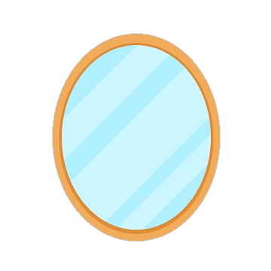
What is on your mind?
or
How are you feeling?
Reflection
©2019 Pure Edge, Inc.
Notes:
Ask a few people to share out if they noticed a difference in how they answered the question before and after. (Can ask this after the quick break).

Slide 5
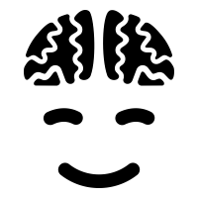

Welcomimg Activity: Mindful Minute
©2020 Pure Edge, Inc.
Notes:
Mindful Minute: Eyes closed or open. Breath awareness, body scan, check in with thoughts/feelings/energy level.

Slide 6
Learning Objectives
  Recognize the physiological response to stress.
  Understand the reciprocal nature of stress.
  Experience self-care practices throughout the session.
©2020 Pure Edge, Inc.

Slide 7


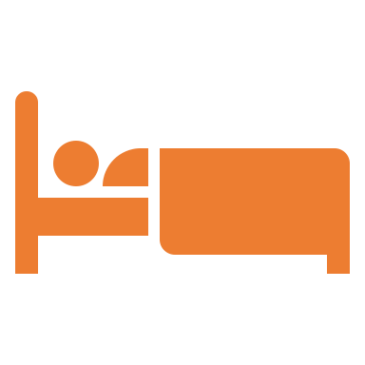




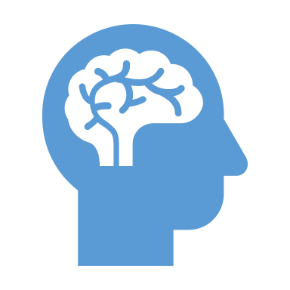

STRESSOR: Pandemic (CDC)
Health-related fear
Worsening of chronic health problems
Sleep problems
Increased use of alcohol, tobacco, and other drugs
Eating problems
Isolation
  50% of 20K responders reported feeling lonely (Cigna Survey)
Concentration problems
©2020 Pure Edge, Inc.

Slide 8
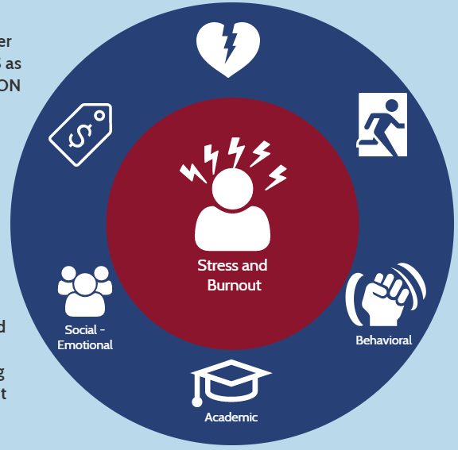
Why Focus on School Stress?
In highly stressed school environments, teachers and learners pay the costs.
40-50%
of new teachers leave within first 5 years.
Teacher turnover:
$2 BILLION
each year
High DAILY levels of stress:
46% of teachers
“Stress and disappointments”:
49% of teachers
say it isn’t worth it.
New principals NOT retained beyond third year:
50%
When teachers are highly stressed, students show lower levels
of both social adjustment and academic performance.
Sources (clockwise from 40-50%): Ingersoll, Merrill & Stuckey (2014); Greenberg, Brown, Abenavoli (2016); School Leaders Network (2014); Rentner, Kober, Frizzell, (2016); Alliance for Excellent Education (2014).
©2020 Pure Edge, Inc.
Notes:
Go over statistics. Highlight that stress is an issue across the field of education. Stress has impact on both educators and learners.

Slide 9
Principal & Superintendent Stress
School leaders experience “physical and psychological effects, burnout, flat-out emotional exhaustion’’ and depersonalization.
A study found that “illnesses that were reported by the largest percentages of superintendents -- high cholesterol, high blood pressure, obesity, gastrointestinal problems, insomnia, anxiety, sleep apnea, and chronic headaches -- are attributed by superintendents to high levels of stress.”
1. Glass, T. E., & Franceschini, L. (2007). The state of the American school superintendency: A mid-decade study. American Association of School Administrators: Arlington VA, Rowman & Littlefield Education.
2. http://jehdnet.com/journals/jehd/Vol_5_No_1_March_2016/13.pdf
3. https://www.aasa.org/SchoolAdministratorArticle.aspx?id=10740
©2019 Pure Edge, Inc.

Slide 10
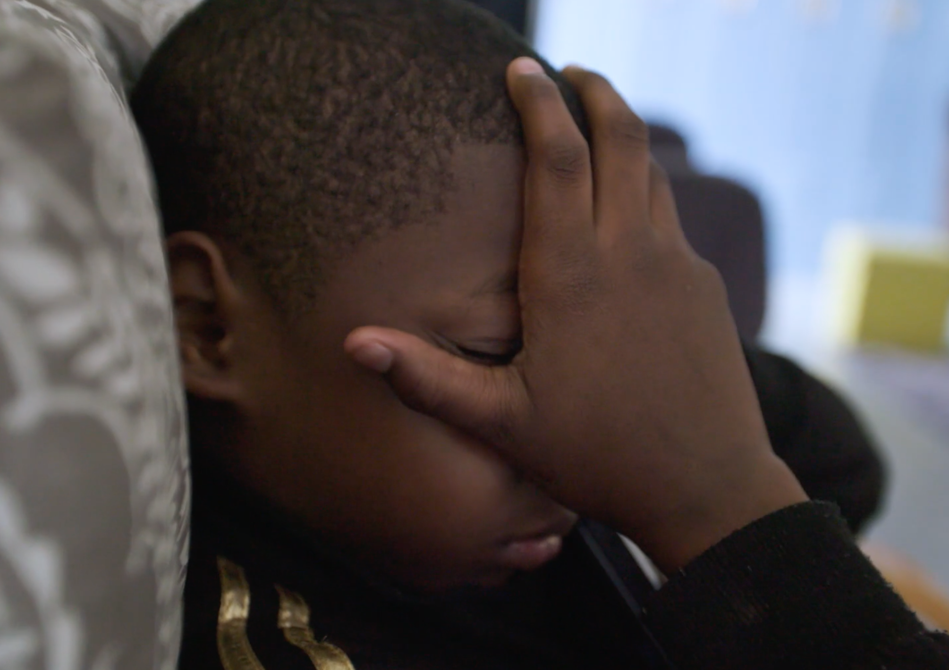
Stress Is Contagious
Higher cortisol levels were found in students whose teachers reported high levels of stress and burnout.
Researcher Kimberly Schonert-Reichl (University of British Columbia) urges educators to be aware of their own mindsets and to practice mental wellness exercises to reduce their stress levels.
www.tricitynews.com/news/stress-is-contagious-education-leaders-told-1.24030014
©2020 Pure Edge, Inc.

Slide 11



In order to have an impact on others, you must first have an impact on yourself.
©2020 Pure Edge, Inc.

Slide 12

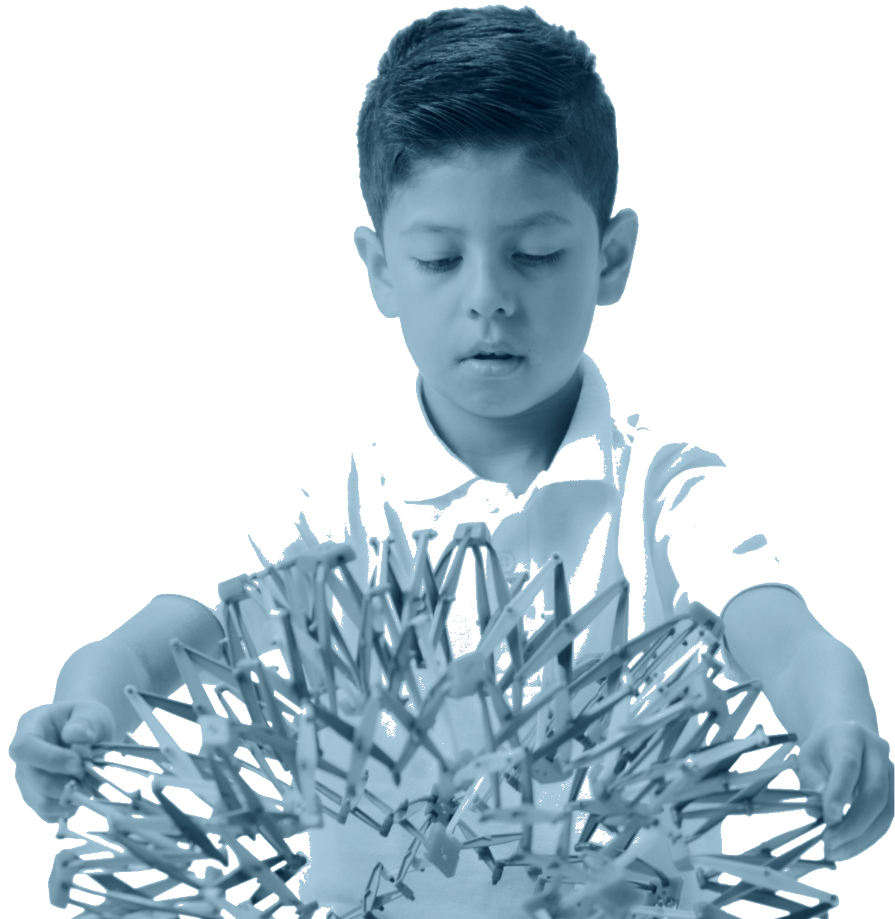


Breathe
Move
Rest
©2020 Pure Edge, Inc.

Slide 13
What we hope to do
  Respond
  Vs.
  React
©2020 Pure Edge, Inc.
Notes:
We are giving kid the tools from as young as possible to be able to respond as opposed to react. Training them to avoid having a dysregulated stress response.

Slide 14
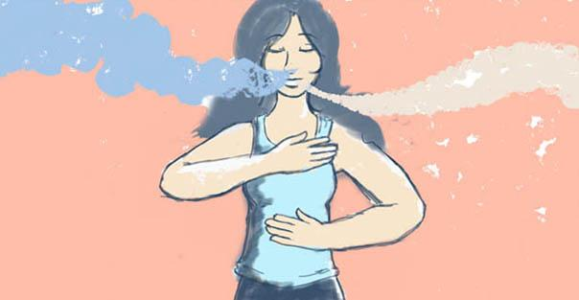
Benefits of Nasal Breathing
  Filters dust and impurities from the air
  Warms the air to body temperature
  The diaphragm is more easily controlled, which supports the development of internal core strength
  More control over lengthening the breath (extended exhalations help activate the parasympathetic nervous system)
  Increased oxygen from nasal breath increases energy and vitality
Northwestern University. "Rhythm of breathing affects memory, fear: Breathing is not just for oxygen; it's also linked to brain function, behavior." ScienceDaily. ScienceDaily, 7 December 2016. www.sciencedaily.com/releases/2016/12/161207093034.htm
This Photo by Unknown Author is licensed under CC BY-SA
©2020 Pure Edge, Inc.
Notes:
Filters dust and impurities from the air
Warms the air to body temperature
The diaphragm is more easily controlled, which supports the development of internal core strength
More control over lengthening the breath (extended exhalations help activate the parasympathetic nervous system)
Increased oxygen from nasal breath increases energy and vitality
Curriculum Level: 6-12
Unit: 1
Lesson: 1.6
Page #: 33
Curriculum Theme: Breathing Benefits
Lesson/Unit Content: "Verbally list three benefits of nasal breathing: two physical and one emotional"

Slide 15

Engaging Activity: Even In – Even Out
©2020 Pure Edge, Inc.
Notes:
Start in Seated Mountain with a tall spine, relaxed shoulders, and eyes gently closed.
Breathe naturally through the nose.
We are going to focus on making our inhales and exhales even.
Inhale deeply through the nose and exhale through the mouth for a count of one.
On the next breath, lets count to two on the inhale and the exhale.
Repeat, continuing to extend the breath up to a count of five.

Slide 16

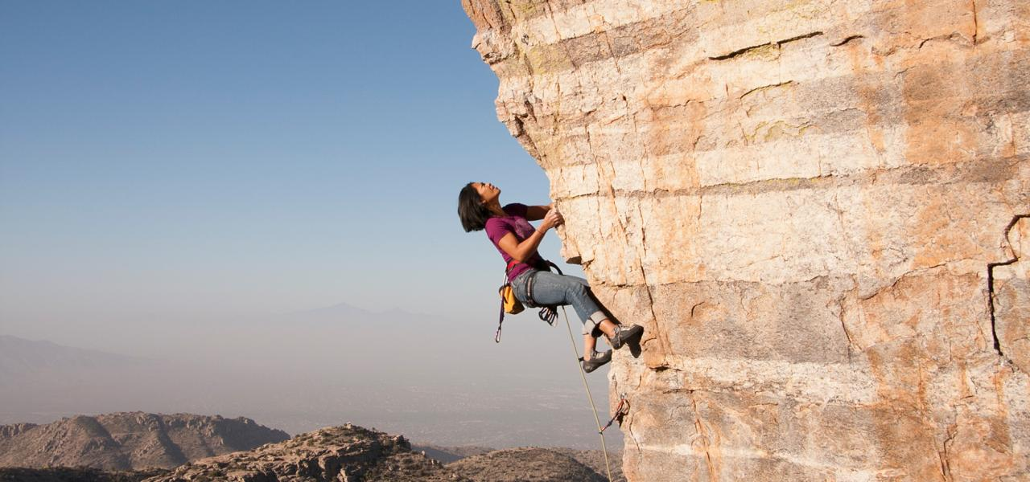
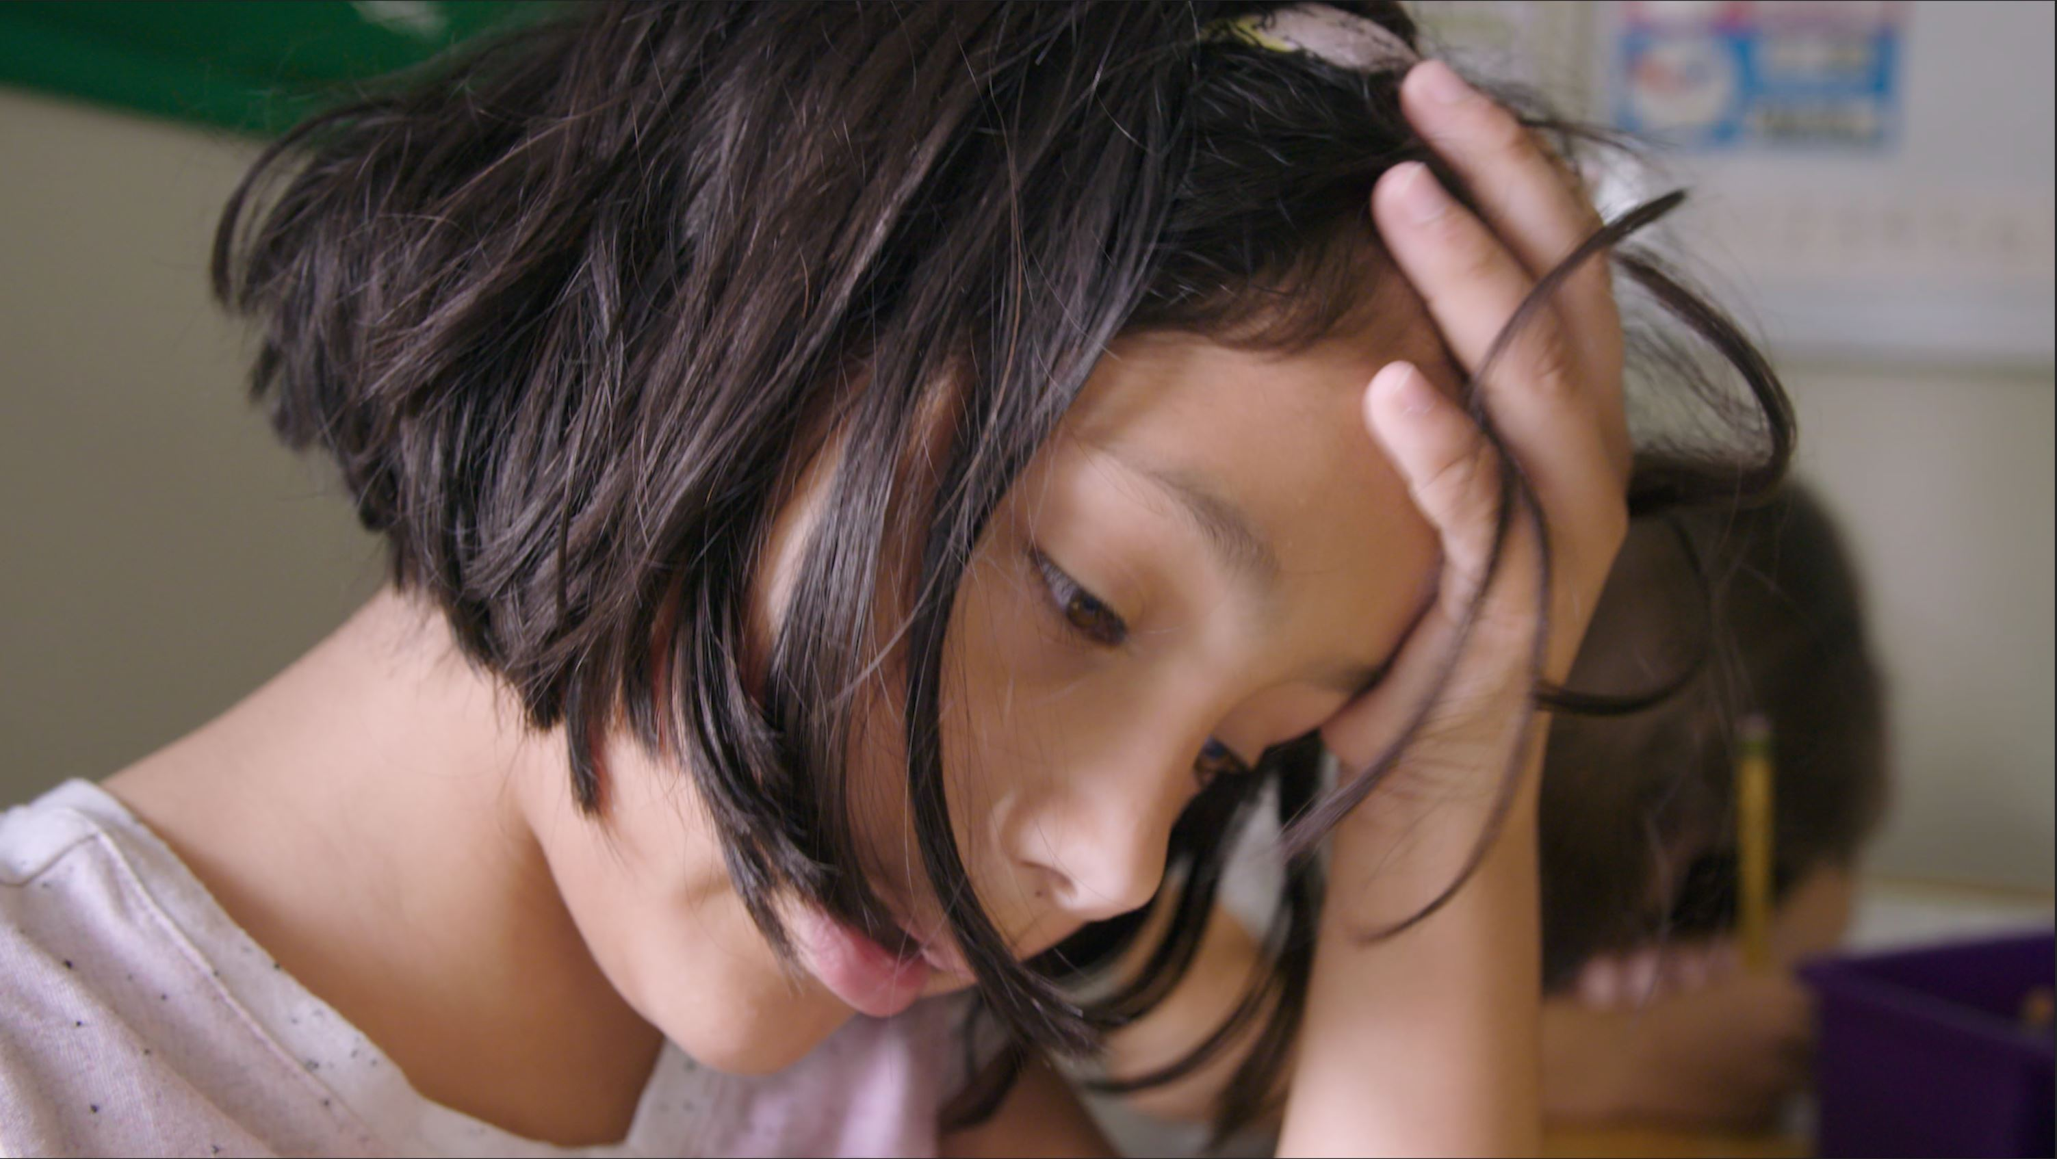
A physiological reaction that prepares an individual to respond to a stressor.
The stressor is usually something that threatens the well-being or homeostasis (stable equilibrium) of the individual.
What is stress?
What is a stressor?
Photo sources: www.discoveravalon.life/best-skiing-western-north-carolina/ , www.visittucson.org/things-to-do/adventure-sports/rock-climbing, People Images/iStock
©2020 Pure Edge, Inc.
Notes:
Use Breathing ball to demonstrate the feeling of stress vs calm by moving it rapidly or slowly.
Ask the group what does stress feel like to you.
Point out that stress is necessary for growth, not all stress is bad.
Curriculum Level: 6-12
Unit: 4
Lesson: 4.4
Page #: 185
Curriculum Theme: Identifying and Regulating Stress
Lesson/Unit Content: "Describe and discuss the benefits of stress regulation in terms relevant to their lives.“

Slide 17
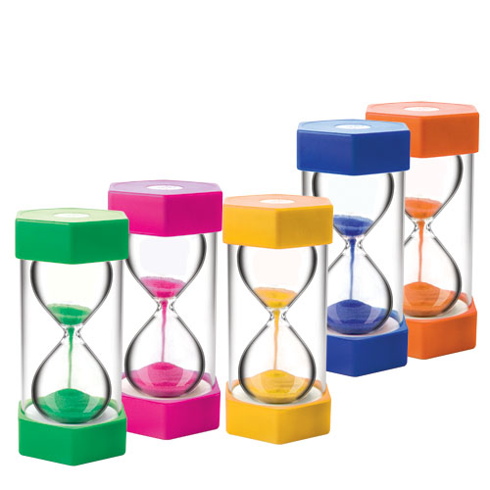

Engaging Activity: Think-Ink-Share
Where do you feel stress in your body?
Where do you feel joy in your body?
www.casel.org
This Photo by Unknown Author is licensed under CC BY-NC-ND
©2020 Pure Edge, Inc.

Slide 18
Benefits
Detriments
Positive challenge
Motivates us to take action
Promotes well-being
Enhances performance
No relief in sight
Makes us physically sick
Weakens immune system
Impairs performance
Marc Brackett, PhD Yale Center for Emotional Intelligence
Victor Carrion, MD Stanford School of Medicine
©2020 Pure Edge, Inc.

Slide 19
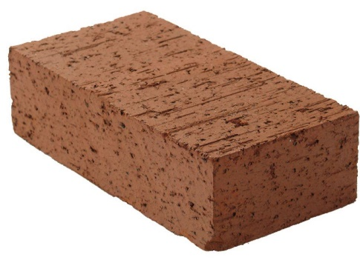



Stress Accumulates **** Allostatic Load
CRISIS
TRAUMA
Allostatic load is "the wear and tear on the body," which accumulates as an individual is exposed to repeated or chronic stress.
PEERS
FAMILY
WORK
HEALTH
©2020 Pure Edge, Inc.
McEwen, BS; Stellar, E (Sep 27, 1993). "Stress and the individual. Mechanisms leading to disease". Archives of Internal Medicine. 153 (18): 2093–101.
Notes:
Use backpack analogy: Allostatic load is "the wear and tear on the body" which accumulates as an individual is exposed to repeated or chronic stress.
The term was coined by McEwen and Stellar in 1993

Slide 20
Engaging Activity: Starfish Breathing or Take Five
©2020 Pure Edge, Inc.
Notes:
1. Make a starfish with one hand, fingers spread wide.
2. Put the index finger from the other hand on the outer base of the thumb.
3. We are going to trace the outline of our starfish hand. Keep looking at your pointer finger while you do your breathing.
4. Inhale (finger traces to top of thumb).
5. Exhale (finger traces down the other side of thumb).
6. Repeat until you have traced the outline of the starfish hand.
*Learners are synchronizing their movement, breath, and gaze. On the inhale, index finger and eyes trace upward along a finger; on the exhale, index finger and eyes trace downward along a finger. Each upward movement is coupled with an inhale, whereas each downward movement is coupled with an exhale.
*After Starfish Breathing, you can have learners rest their hands on their chest, continuing to breathe mindfully, as they silently recall three things for which they are thankful

Slide 21
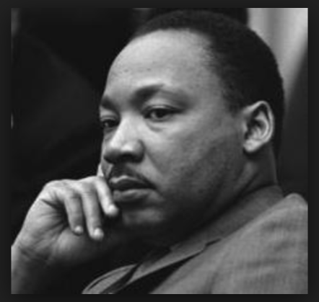
Impact of Stress & Trauma on the Heart
After his death, Dr. Martin Luther King Jr.'s autopsy found that while he was just 39 years old, he had the heart of a 60-year-old.
Image Source: https://www.nobelprize.org/prizes/peace/1964/king/biographical/
©2020 Pure Edge, Inc.
Notes:
He took care of a Nation. Emphasize that stress has physiological and long term health impacts.

Slide 22
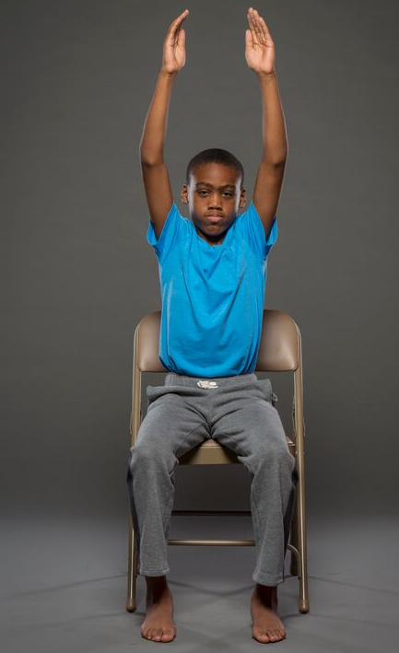
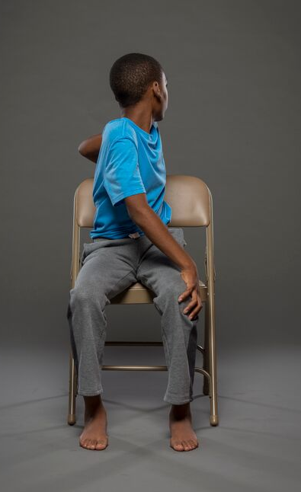
Engaging Activity: Chair Sunrise Twist
©2020 Pure Edge, Inc.
Notes:
1. Sit in Seated Mountain.
2. Inhale, stretch arms overhead for Chair Sunrise.
3. Exhale, twist to the right, placing left hand on right knee and right hand on right hip or back of the chair. Keep right shoulder relaxed. Take a few breaths here.
4. Inhale, back to Seated Sunrise.
5. Exhale, twist to the left, placing right hand on left knee and left hand on left hip or back of chair. Keep left shoulder relaxed. Take a few breaths here.
6. Inhale back to Seated Sunrise.
7. Exhale to Seated Mountain.

Slide 23

Educator Self-care
Improved mood
Neurochemicals
Endorphins
Neurotransmitters
Improved memory
This Photo by Unknown Author is licensed under CC BY-NC
©2020 Pure Edge, Inc.
Notes:
Exercise is like getting a bubble bath of all the good neurochemicals for the brain.

Slide 24
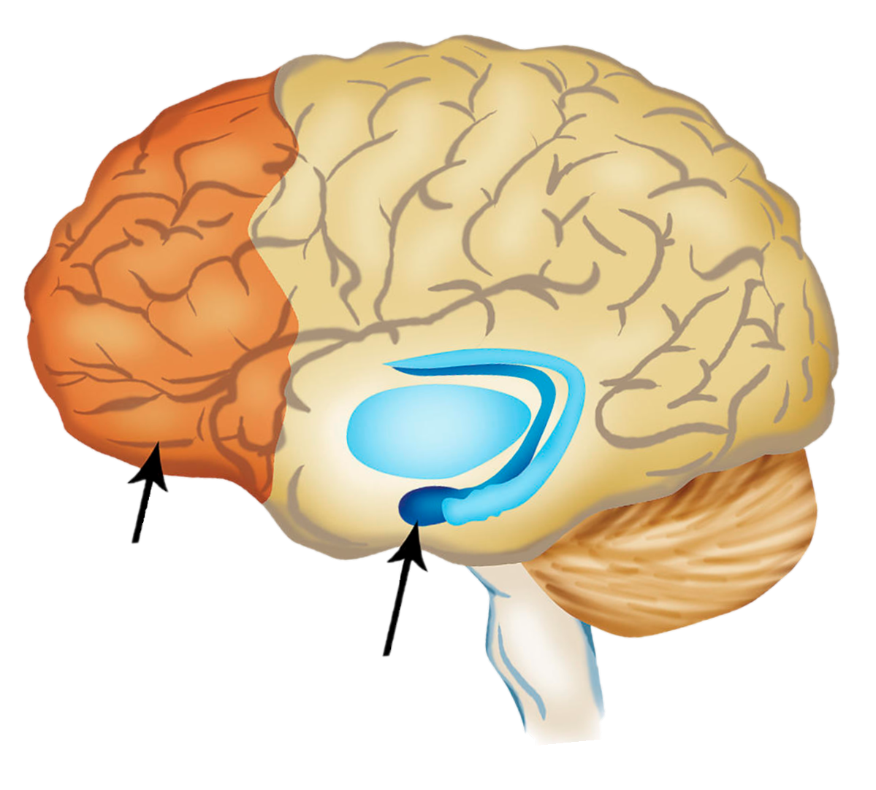
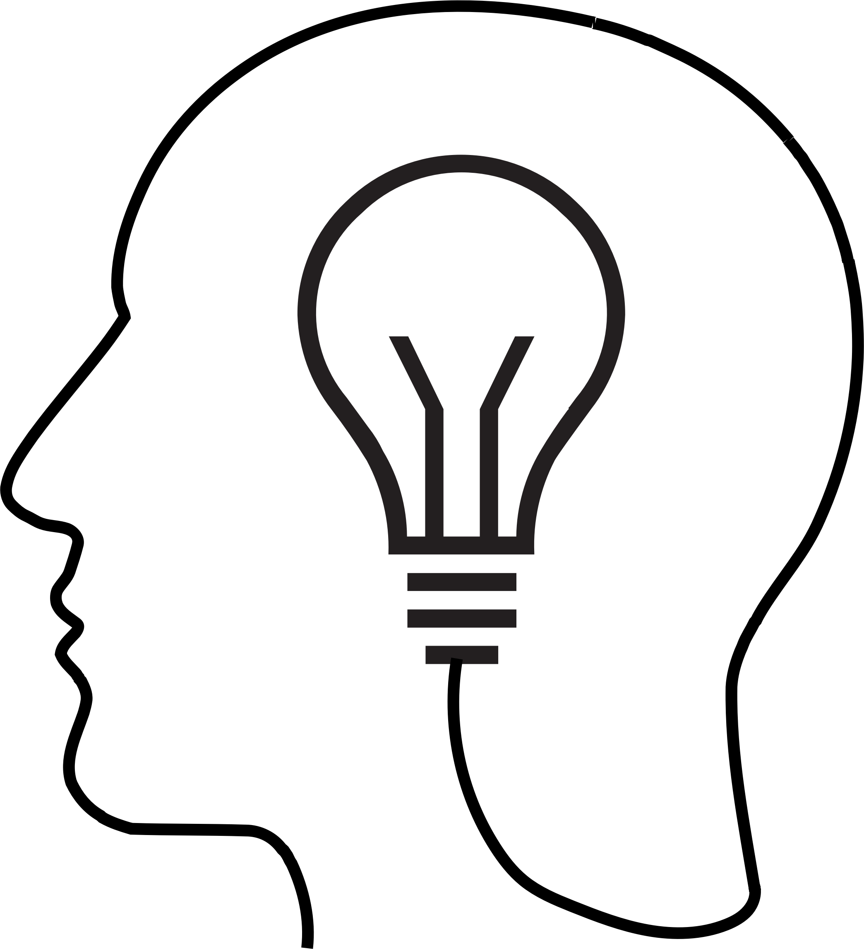
Neuroscience
The rational part of the brain, the Prefrontal Cortex, isn’t fully developed until age 25 or so.
Adults think with the prefrontal cortex, the brain’s rational part. This is the part of the brain that responds to situations with good judgment and an awareness of long-term consequences.
Children, teens, and young adults rely on the amygdala to process information; the emotional part of the brain.
Prefrontal Cortex
Amygdala
©2020 Pure Edge, Inc.
Notes:
Close with, “over time, as the state of the body is observed, one can begin to clearly observe thoughts and feelings, as well.”

Slide 25
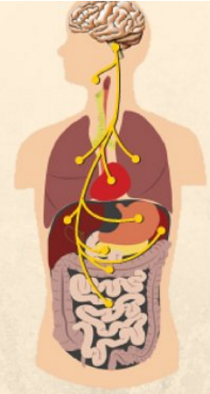
Neuroscience: Self-care & Vagal Tone
THE VAGUS NERVE
How to Hack Your Nervous System
The vagus nerve, the tenth cranial nerve, is the superhighway of the nervous system that connects the body and brain. We can tone the vagus nerve through deep breathing exercises.
http://depressivedisorder.blogspot.com/2015/09/7-ways-to-stimulate-your-vagus-nerve-to.html https://www.yogauonline.com/yogau-wellness-blog/vital-vagus-what-vagus-nerve-and-what-does-it-do
©2020 Pure Edge, Inc.
Notes:
Vagus Nerve: Longest nerve in the body. Touches all the internal organs. Messenger between mind and body & body and mind.
Define Vagal Tone: the vagus nerve becomes more efficient at its job.
Deep breathing (nasal) improves vagal tone.

Slide 26
“
“The three most important aspects of learning
—attention, focus, and memory—
are all controlled by our emotions,
not by cognition.”
“
~Marc Brackett
Brackett Ph.D., M. (2019). Permission to Feel: Unlocking the Power of Emotions to Help Our Kids, Ourselves, and Our Society Thrive. New York, NY: Celadon Books.
©2020 Pure Edge, Inc.
Notes:
The circuits involved in emotion regulation are highly interactive with those associated with “executive functions” (such as planning, and decision-making), which are intimately involved in the development of problem-solving skills during the preschool years.

Slide 27
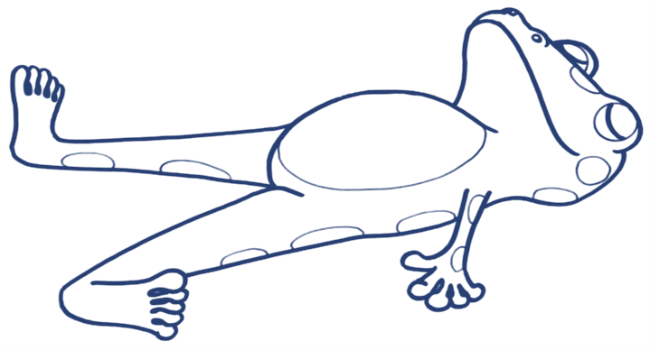
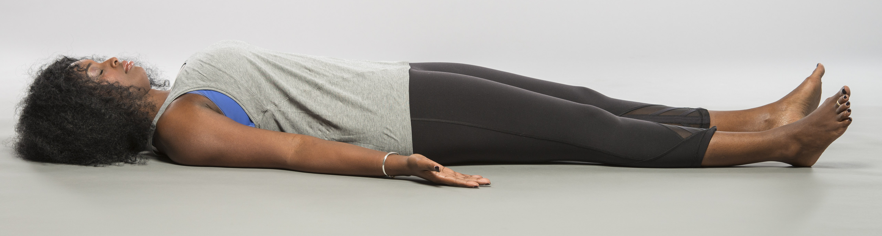
Optimistic Closure: Guided Rest / Body Scan
©2020 Pure Edge, Inc.
Notes:
1. Lie down on the floor on your back. Spread your feet apart. Turn your palms up to face the ceiling and close your eyes.
2. Put your attention on your forehead. Feel your forehead relax.
3. Put your attention on your eyes. Feel your eyes relax.
4. Put your attention on your cheeks and jaw. Feel your cheeks and jaw relax.
5. Put your attention on your neck. Feel your neck relax.
6. Put your attention on your shoulders. Feel your shoulders relax. (Repeat for arms, wrists, hands, fingers.)
7. Put your attention on your chest. Feel your chest relax.
8. Put your attention on your back. Feel where your back touches the floor (or the chair).
9. Put your attention on your belly. Notice how the breath moves the belly softly up and down.
10. Put your attention on your hips. Feel your hips relax. (Repeat for legs, knees, ankles, feet, toes.)
11. Bring your awareness to your breathing, and notice where you feel the breath in your body. Maybe you notice it in your nostrils. Maybe you feel it in your chest. Maybe you feel it in your belly.
12. See if you can get really quiet. Maybe you will even feel your heart beating inside your body.
13. Let learners rest in silence for a few moments.
14. Ring chime.
15. Slowly start to wiggle your fingers and toes. Take a deep breath in and stretch your arms overhead. As you exhale, relax.
16. Open your eyes and slowly return to a seated position.
17. Notice how you are feeling.
*If space permits, have learners lie down in a circle with their heads pointing toward the center. Learners may practice Guided Rest seated at their desks if lying down is not convenient.
*Using a soft stuffed animal as a “breathing buddy” can help learners relax. The breathing buddy can rest on the learner’s belly and help the learner to notice their breathing.
*You can shorten the exercise by leaving out some body parts.
*Learners who do not feel comfortable lying on their back may lie on their bellies, although lying on backs is the ideal position for helping the body to relax in this exercise and should be encouraged.
*5 minute exercise.

Slide 28
What is on your mind?
or
How are you feeling?
Reflection
©2019 Pure Edge, Inc.
Notes:
Ask a few people to share out if they noticed a difference in how they answered the question before and after. (Can ask this after the quick break).

Slide 29
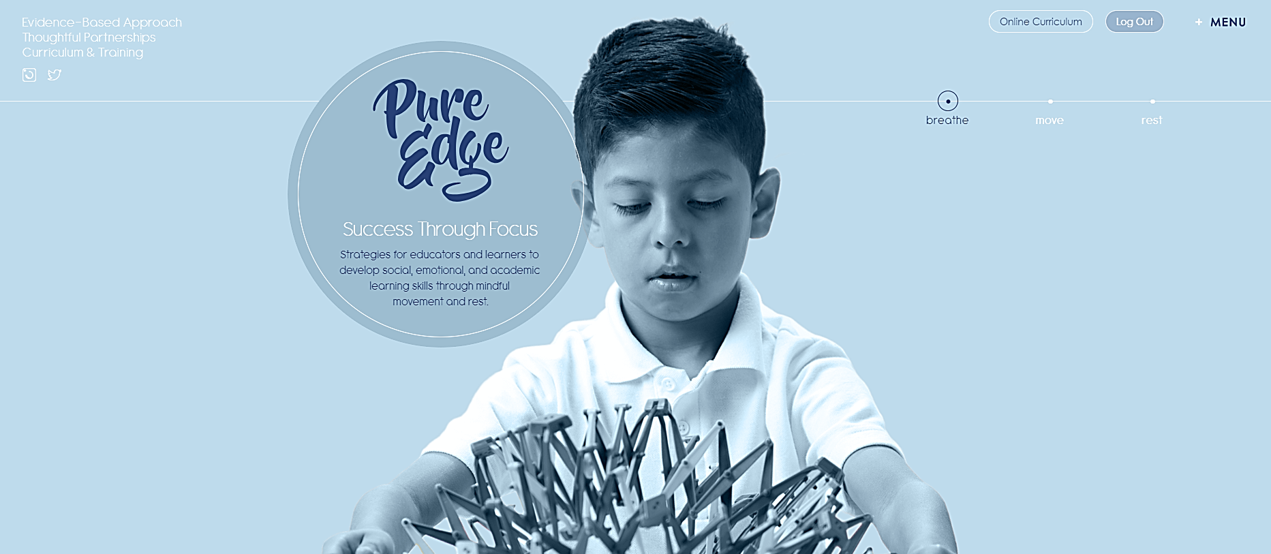
pureedgeinc.org
©2020 Pure Edge, Inc.
Notes:
Show how to register for an account. If time allows have them register.
Have them use work email.
Walk them through how to access resources from today’s presentation .

Slide 30
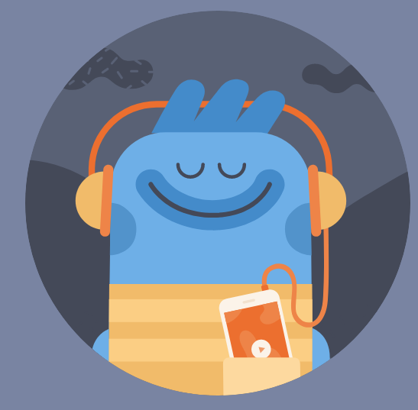

HEADSPACE: Mindfulness On Demand
Headspace is donating their app
to all Educators.
go.headspace.com/pureedge
Use your work email address
©2020 Pure Edge, Inc.

